Slide 1




Higgs and SUSY searches in CMS
Rebeca González Suárez
for the CMS collaboration
29 November 2010
II CPAN days, Valencia

Slide 2
Introduction
The Standard Model (SM) of Particle Physics is in very good agreement with the experimental data, but there are still some uncovered aspects, open questions that the LHC will try to answer
Reveal the physical mechanism responsible for the breaking of electroweak symmetry, responsible for the masses of the particles
A simple mechanism (among many others) that can be incorporated to the SM to solve this is the Higgs Mechanism, that leaves the SM mostly untouched and:
- adds one additional scalar boson that has to be detected, the Higgs boson
Supersymmetry gives a solution for the hierarchy problem (protect m_{H} from divergence) and the unification of all the forces including gravity, also provides an important candidate for Dark Matter
This talk reviews some of the searches oriented to find a SM Higgs boson and introduces Minimal Supersymmetric (MSSM) and Supersymmetric (SUSY) searches in CMS, with prospects for the early running of the LHC

Slide 3
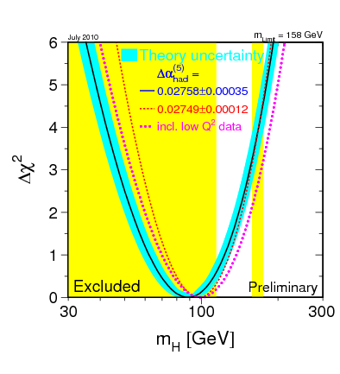
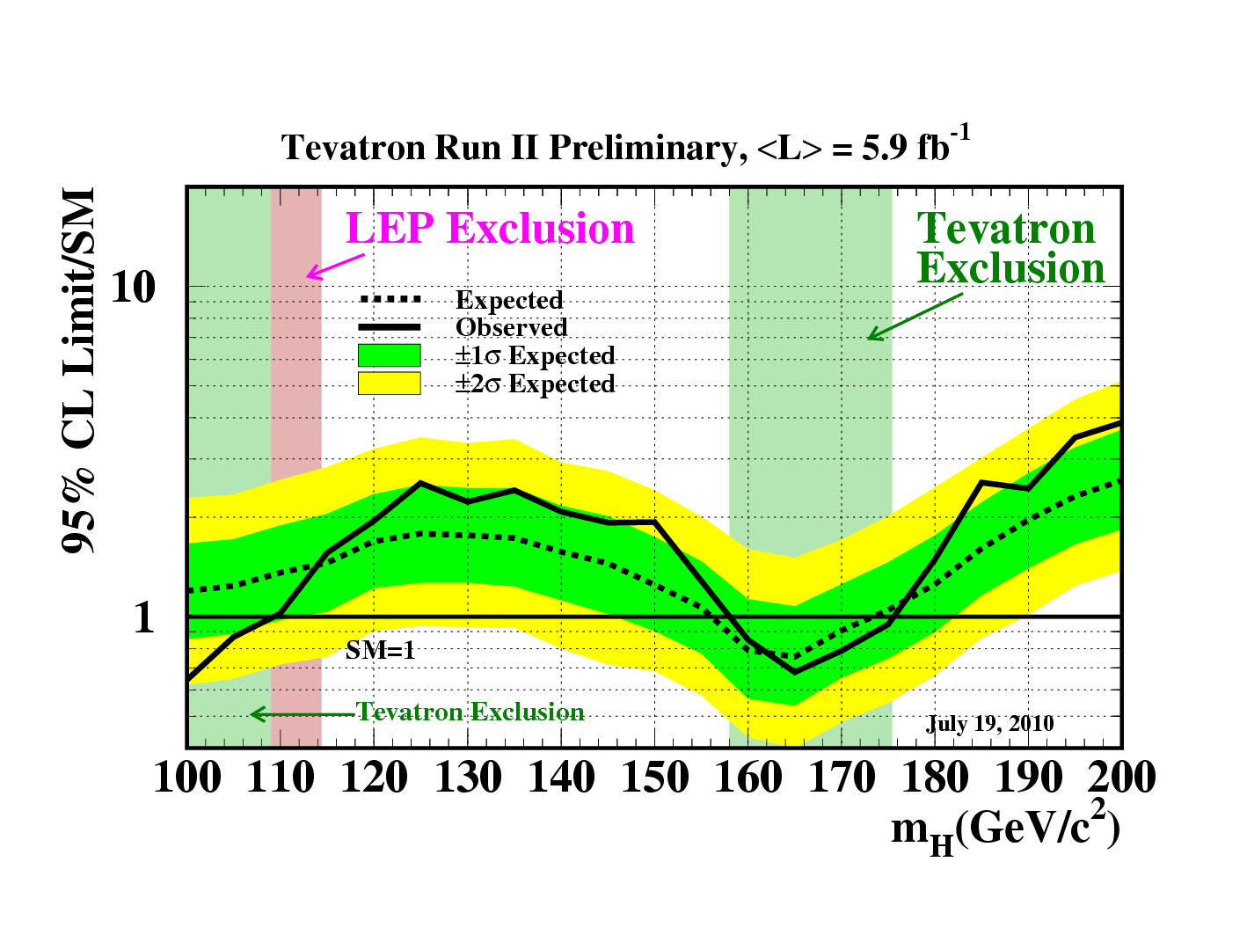
Previous and Current Higgs Searches
Current search scenario defined by direct and indirect measures:
LEP set a 95% CL limit of m_{H} ≥ 114.4 GeV/c²
Precision electroweak measurements tell that, for a Standard-Model Higgs boson:
m_{H} < ~158 (185 GeV/c² with LEP-2 data)
The most recent combined result from the Tevatron experiments CDF and DØ, excludes the mass range between 158 and 175 GeV/c², and between 100 and 109 GeV/c² at 95% CL

Slide 4
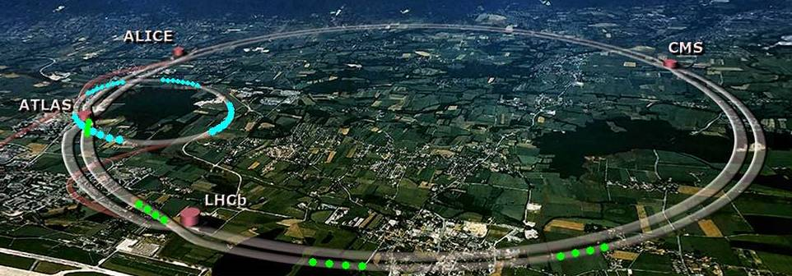
The Large Hadron Collider
The Large Hadron Collider (LHC) the largest and highest-energy particle accelerator of the world, located at CERN (Geneva, Switzerland)
It has 4 big experiments (ALICE, ATLAS, CMS, LHCb), two of them (CMS and ATLAS) intended for general purposes
It operated at a proton-proton collision energy of 7 TeV since March 30th 2010
Continuously collecting luminosity in pp collisions until heavy ions run (November 7)
delivering ~ 47pb⁻¹
Plans for next year:
Beam back at the end of February
End of run – 12th December
~200 days proton physics
(+ 4 weeks ion run)
 | “Reasonable numbers” | “Ultimate reach”
Peak luminosity | 6.4 x 10³² | 2.2 x 10³³
Integrated per day | 11 pb⁻¹ | 38 pb⁻¹
200 days | 2.2 fb⁻¹ | 7.6 fb⁻¹
Stored energy | 72 MJ | 134 MJ
Collision energy: 8 TeV
(to be decided in Chamonix)

Slide 5
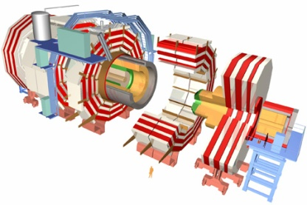
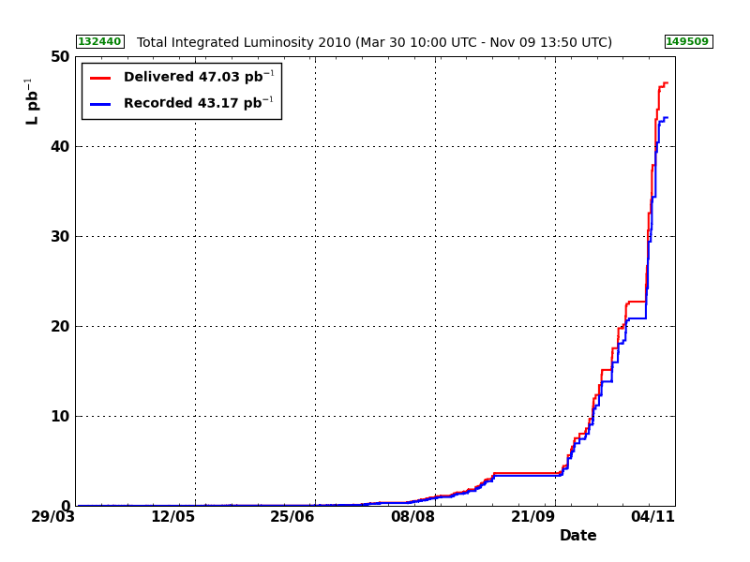
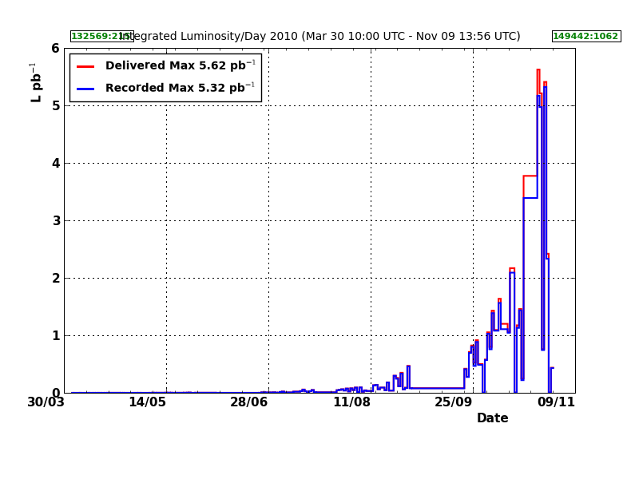
The Compact Muon Solenoid
CMS is, with ATLAS one of the two main general purpose LHC experiments
CMS stands for Compact Muon Solenoid
Compact
“Small” in size when compared to ATLAS, but two times heavier
Muon
Optimized for Muon detection
Solenoid
Magnetic field produced by a superconducting solenoid
2 10 ³² Hz/cm²
LHC Delivered 47 pb⁻¹
CMS recorded 43 pb⁻¹
Overall data taking efficiency 92%
~85% with all sub-detectors in perfect conditions
Heavy Ions: delivered ~ 1.96 μb⁻¹, efficiency > 95%
Integrated lumi/day
10 ²⁷ Hz/cm²

Slide 6
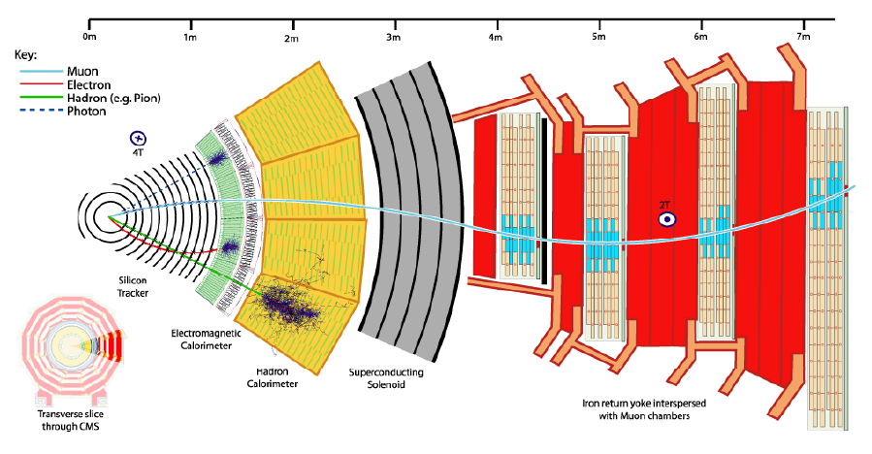
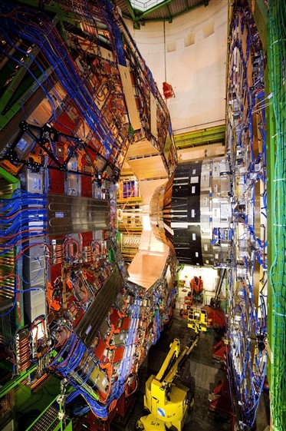
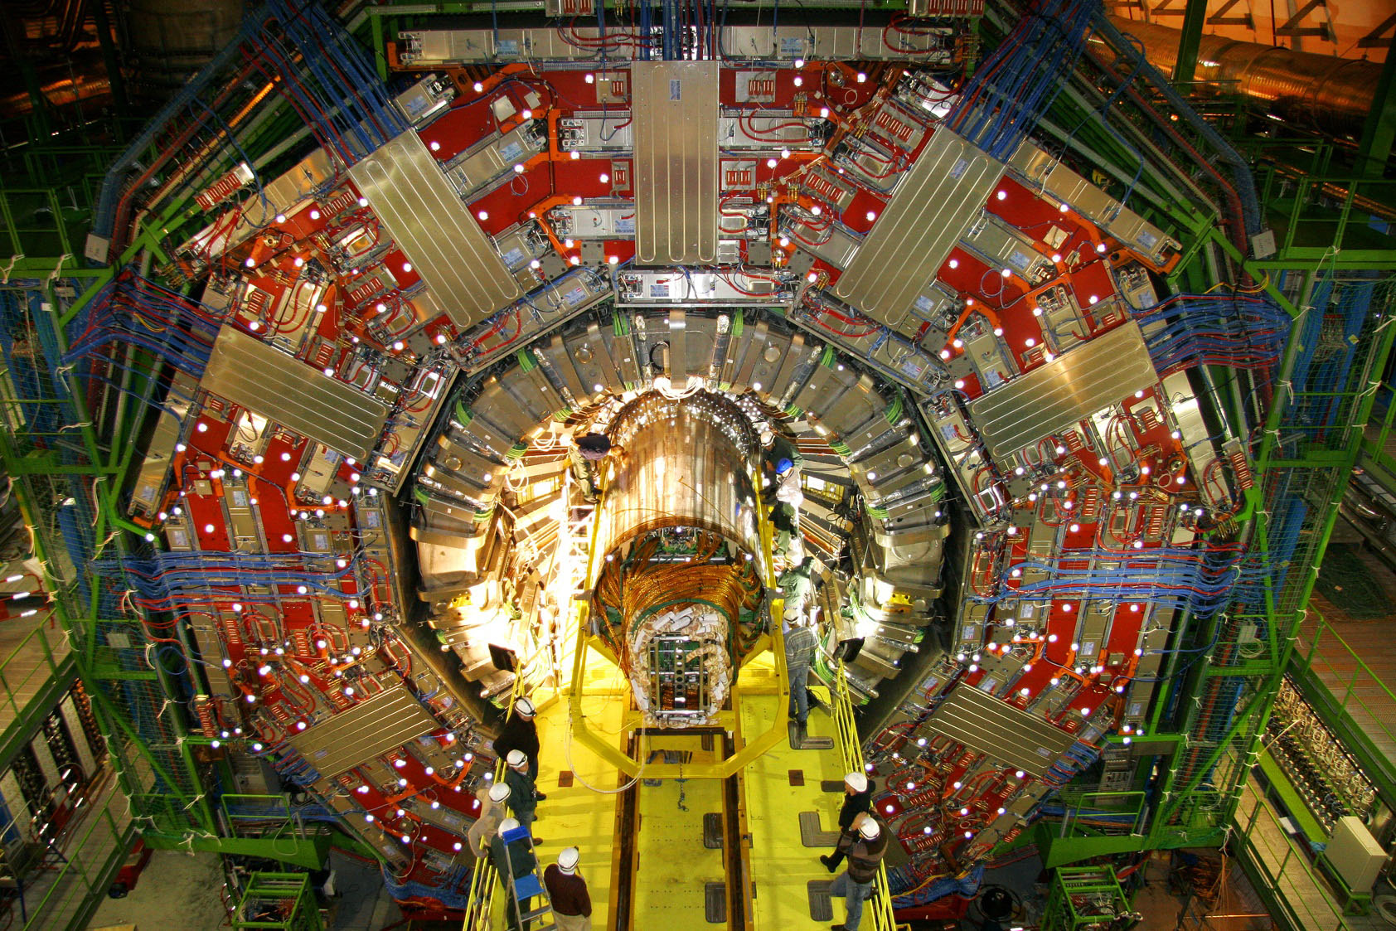
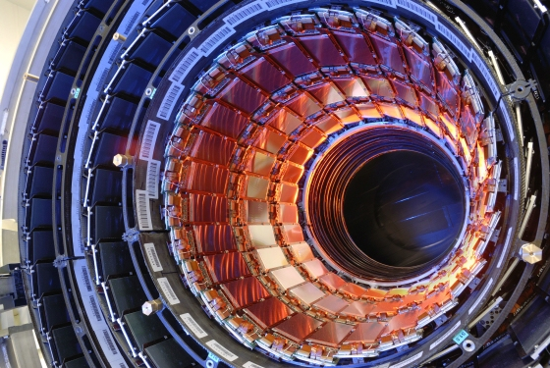
The CMS detectors
Tracker
Charged Particles
Superconducting solenoid
Electromagnetic Calorimeter
(ECAL)
Electrons and photons
Hadronic Calorimeter (HCAL)
Hadrons
Protons, neutrons, pions, kaons…
Jet/MET measurements
Muon System
Identify muons
Measure Pt
Trigger
Drift tubes (DT)
Cathode Strip Chambers (CSC)
Resistive Plate Chambers (RPCs)

Slide 7
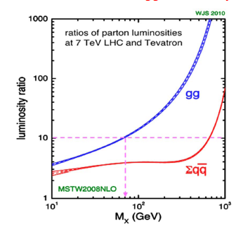
LHC Vs. Tevatron
The Higgs searches at the first period of the LHC will go in paralell with the Tevatron experiments
Expectations 2011
 |  | Energy (TeV) | L (fb⁻¹)
TeVatron | (p+ p-) | 2 | 2
LHC | (p p) | 7-8 | 2-7
The LHC benefits from:
Higher cross-sections
More than a factor 10 for gg processes at certain masses
Better S to B
The effect in the cross-section less pronounced for qq-induced processes, especially at high masses
Detectors optimized for Higgs searches

Slide 8
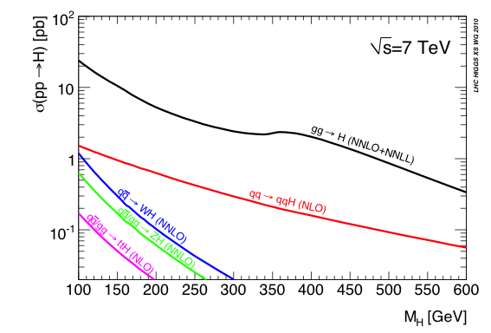
Higgs production at the LHC
The Search Strategy for a particular Higgs mass hypothesis → determined by the production mode and decay channel
Gluon-gluon fusion (ggH):
Dominant production mode
Vector Boson Fusion, VBF (qqH):
Characteristic signature with two forward jets and rapidity gap, increasingly important for high masses
Associated production (WH, ZH, ttH): Relevant in the low mass region, allows for‘easy’ triggering

Slide 9
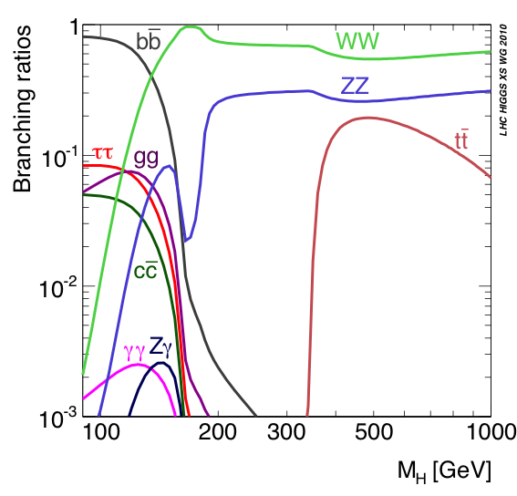
Higgs decay modes
Low mass (m_{H}< 2m_{Z})
H→bb: Highest BR for low masses. Challenging experimentally, huge QCD background
H→ττ: Collinear approx.→mass reco. Accesible through VBF
H→γγ: Mass-peak with good resolution
H→WW: Earliest sensitivity
H→ZZ: Very clean experimental signature with 4 leptons.
High mass (m_{H} > 2m_{Z})
H→tt: Difficult selection

Slide 10
Higgs Searches in CMS
CMS works in a wide range of Higgs decay channels, and will be producing results very soon
gluon-gluon fusion Higgs decaying to → γγ, ZZ, WW
VBF Higgs → WW/ZZ/invisible/ττ
MSSM Higgs → ττ, Light/heavy/double charged Higgs
+ more to come!
Public results with Monte Carlo for different center of mass energies (14-10)
Projections for the current √s 7 and 8 TeV scenarios: Bayesian Exclusion Limits (95%CL) and Significance
About the projections
Using public results at 14 TeV and more recent (not public) studies at 7 and 10 TeV.
Re-scale signal and background event counts to 7-8 TeV cross sections and integrated luminosities of 1-10 fb⁻¹
- No corrections for acceptance at different √s or improvements in reconstruction (efficiencies, resolution)
Systematic errors included (scaled with energy/luminosity)

Slide 11
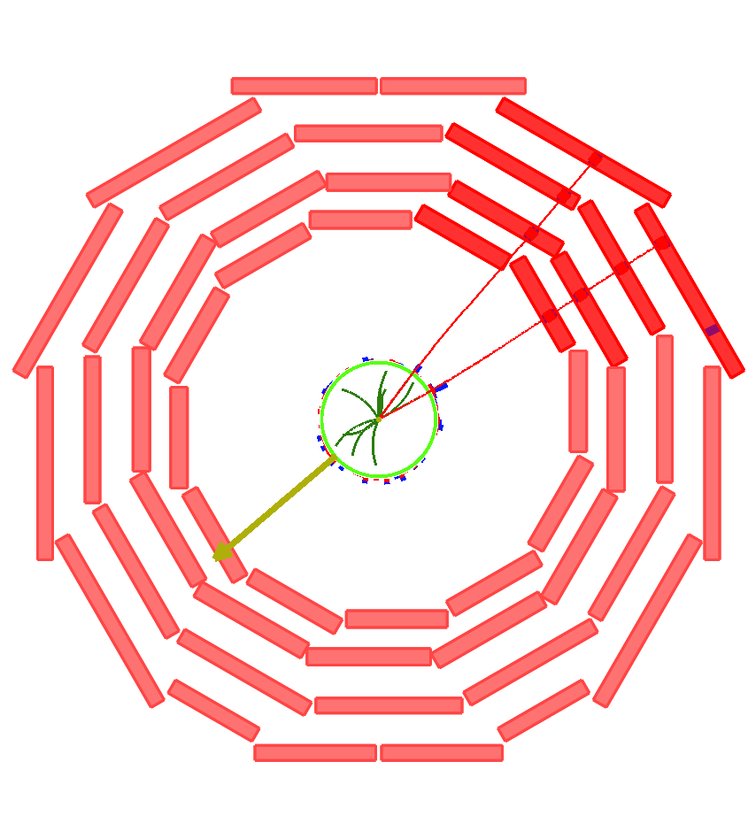
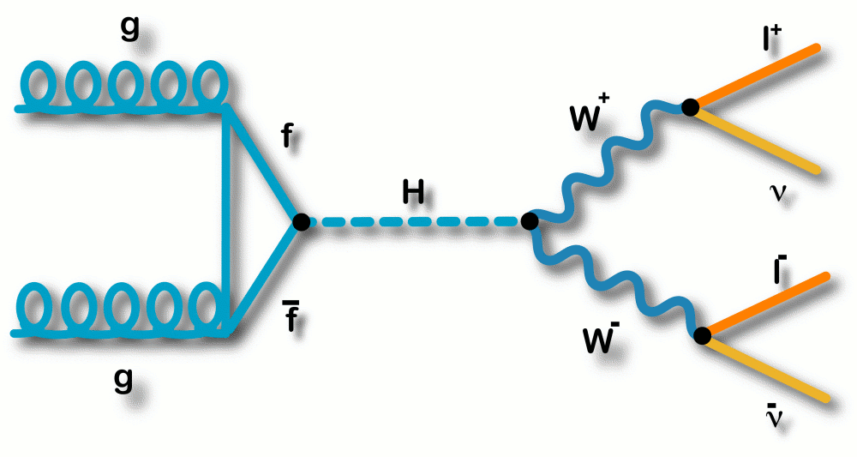
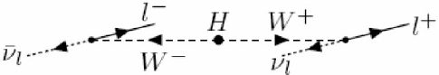
SM H → WW* → 2l2ν
The discovery channel for a SM Higgs boson in a wide mass range in the LHC
Branching ratio close to 1 in
2m_{W} < m_{H} < 2m_{Z}
Clear experimental signature:
2 high PT leptons with opposite charge and a small transverse opening angle (spin correlations)
Missing ET
No jets (GF) or two forward jets with rapidity gap (VBF)
Backgrounds:
Real or fake multi-lepton final states + missing ET:
‘irreducible’ WW (WZ, ZZ),
ttbar (tW),
Drell-yan, W+jets…

Slide 12
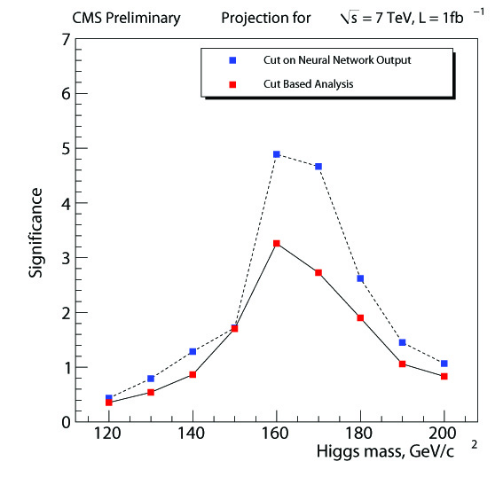
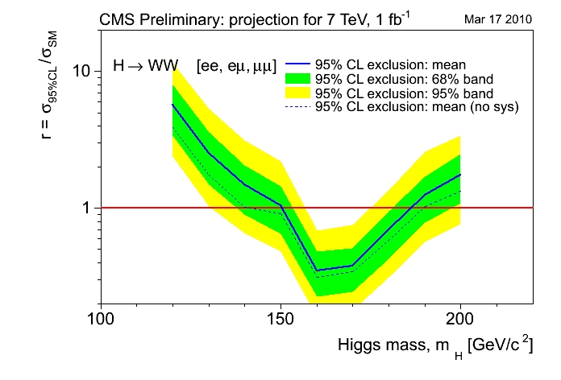
SM H → WW* → 2l2ν
ee, μμ, eμ final states
No mass peak
Good knowledge of backgrounds mandatory (control regions & data-driven methods)
Sequential cuts
Multivariate approach
H+0j (+ independent VBF analysis)
CMS PAS HIG-08-006
7 TeV, ∫Ldt = 1fb⁻¹ (projection)
Exclusion 95%CL: 150<m_{H}<185 GeV
Discovery level sensitivity (~5σ) : 160<m_{H}<170 GeV
CMS AN 2010/008

Slide 13
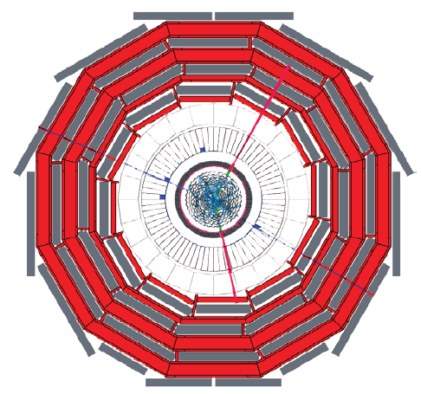
SM H → ZZ*→ 4l
‘Golden’ Higgs decay:
experimentally cleanest signature for discovery
Narrow 4-lepton invariant mass peak on top of a smooth background
Wide mass range
Challenge: m_{H} between 120 and 150
(one of the Z’s off-shell)
Backgrounds:
Irreducible: ZZ* dominant
Reducible: Zbb, tt, ZW, Z + X
2 pairs of same flavour, opposite-sign leptons
(4e, 4µ, 2e2µ)
H mass reconstruction
Lepton isolation & impact parameter cuts
Background estimation by fit on sidebands

Slide 14
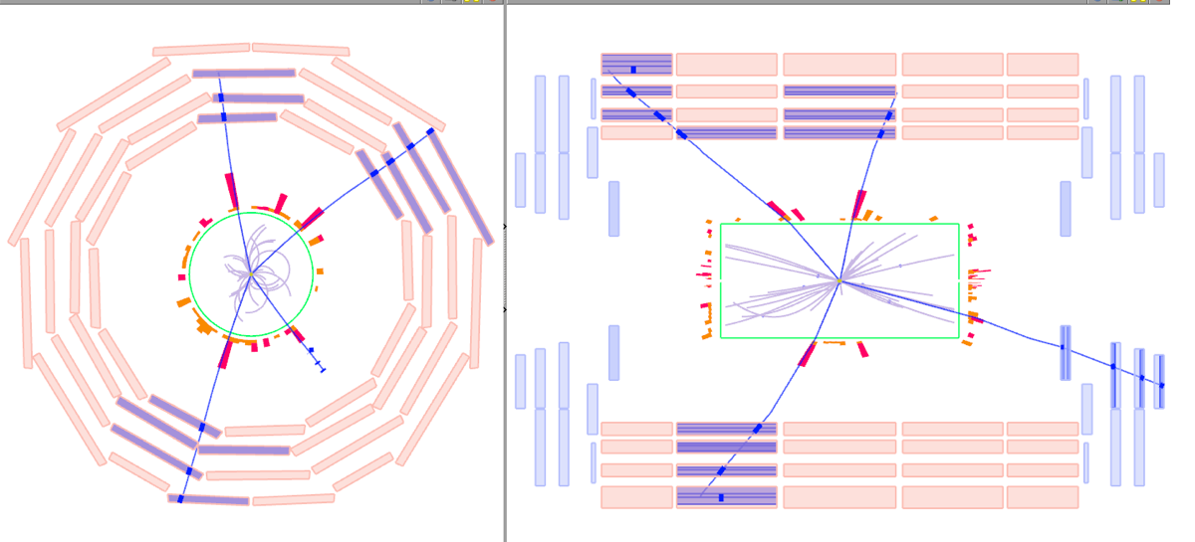
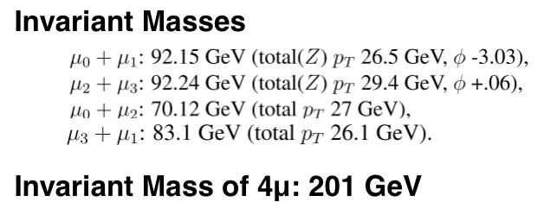
First ZZ candidate
First ZZ → μμμμ candidate
Recorded by CMS

Slide 15
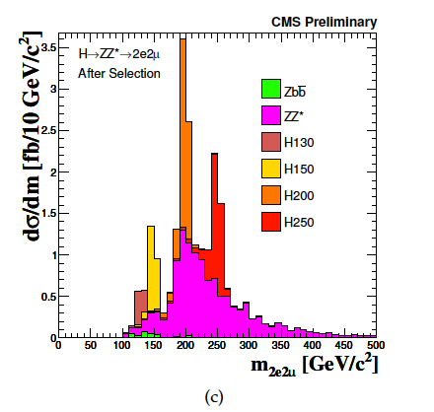
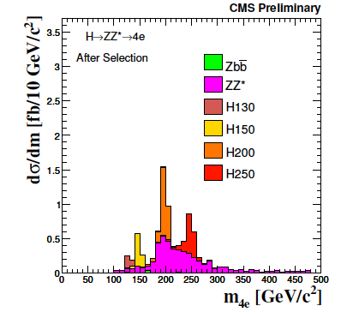
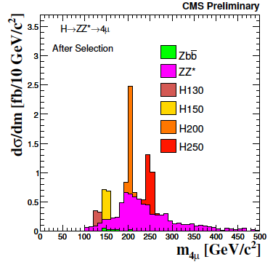
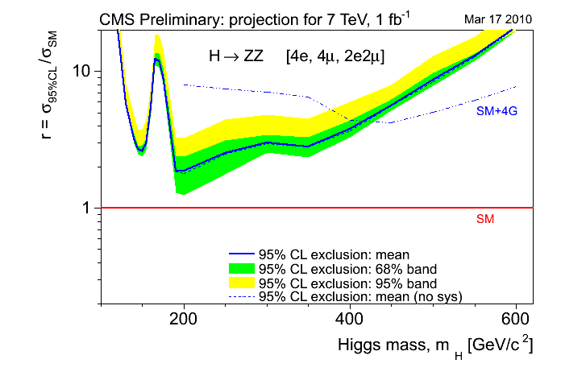
SM H → ZZ*→ 4l
CMS PAS HIG-08-003
7 TeV, ∫Ldt = 1fb⁻¹ (projection)
The SM Higgs boson cannot be excluded anywhere in the entire mass range.
In the 4th generation model* the Higgs boson with a mass:
m_{H}<400 GeV
would be excluded
* An extra doublet of quarks would make the gg→H production rate ~9 times larger, regardless of how massive the the two extra quarks might be.

Slide 16
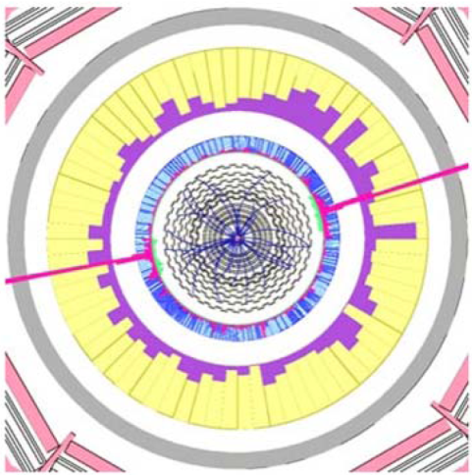
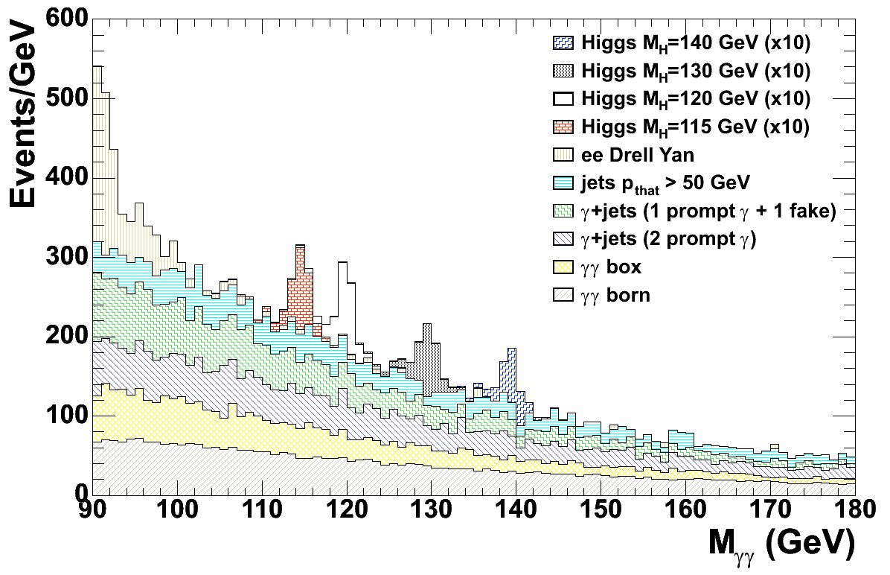
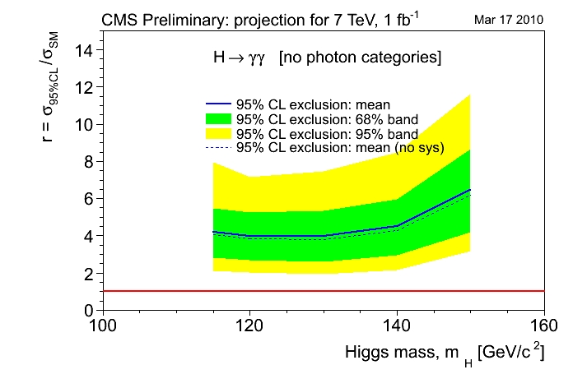
SM H → γγ
Promising channel in the low mass range
(110 < m_{H} < 140 GeV)
Clear signature:
2 High E_{T} isolated photons
Mass peak
Small Branching ratio,
High Luminosity analysis
CMS PTDR
Backgrounds:
γγ, γγ+jets (irreducible)
γ+jets, jets, DY
Background assessed from data sidebands
Cut-based analysis & Event-by-event kinematical Likelihood Ratio
7 TeV, ∫Ldt = 1fb⁻¹ (projection)
The SM Higgs boson cannot be excluded anywhere in the mass range.
A fermio-phobic Higgs* with m_{h}<110 GeV
would be excluded
*The limit on the anomalous production is expected to be about 4 times σ(pp→H_{SM})xBR(H_{SM}→γγ).

Slide 17
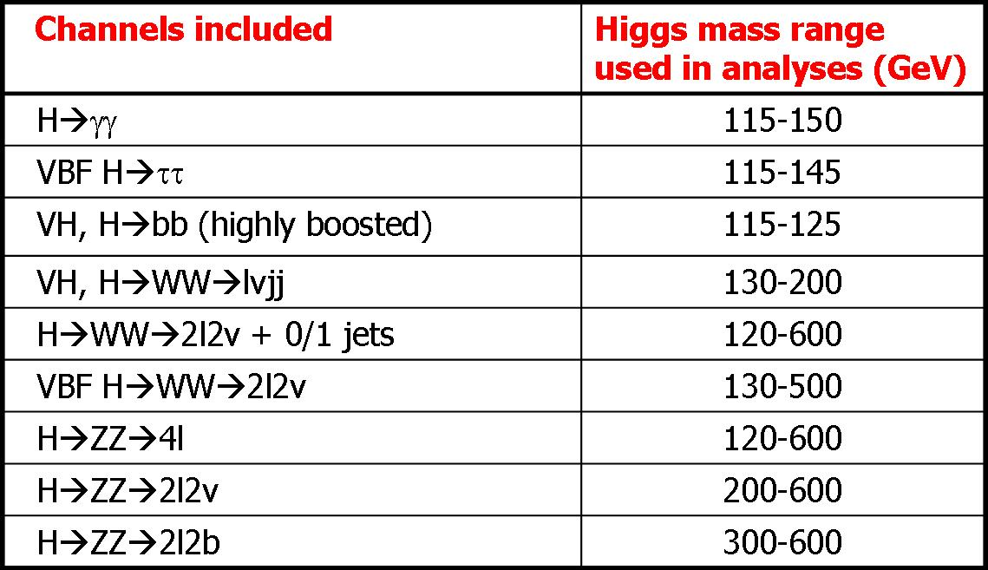
SM Higgs combination
Considering the expected 2011 scenario
Projections are obtained using an expanded list of SM Higgs signatures that are already under study or will be studied as soon as possible in CMS
Considering 7 and 8 TeV as collision energy
Several integrated luminosities: 1-5 fb⁻¹

Slide 18
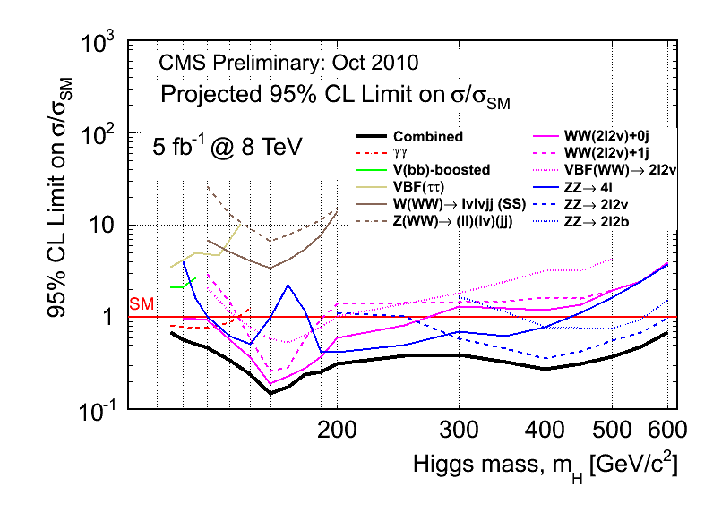
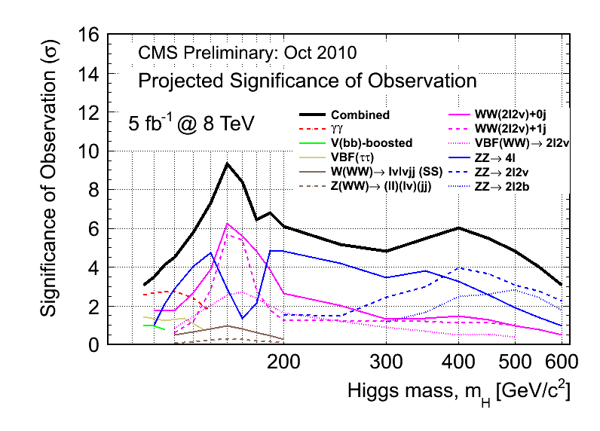
Limits and Significance
Projected exclusion limits and expected observation significance for a SM Higgs search at √S = 8 TeV with L = 5 fb⁻¹
CMS is expected to reach an exclusion sensitivity in the mass range from the LEP limits (114 GeV) to 600 GeV and the observation sensitivity in the same mass range of 114-600 GeV is expected to be 3σ or higher, depending on the Higgs mass

Slide 19
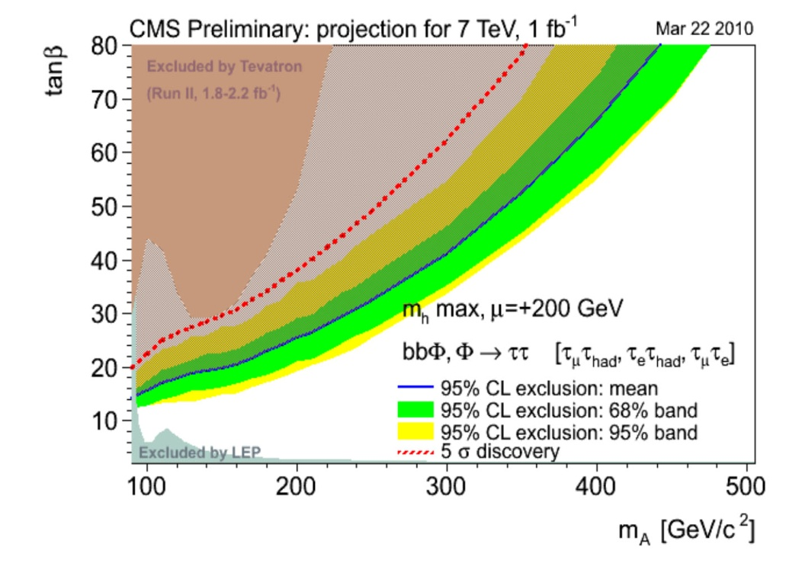
MSSM Higgs
Heavy neutral MSSM Higgs bosons in CMS, bbΦ
→ b quark associated production with subsequent decay to τ leptons
Final states with:
Isolated pairs of (τ_{had}τ_{μ}) (τ_{had}τ_{e}) (τ_{e}τ_{μ})
MET
one b-tagged jet, veto extra jets
counting events in ττ−mass window (collinear approximation)
Backgrounds:
Z+bb/cc/jets
tt
7 TeV, ∫Ldt = 1fb⁻¹ (projection)
pp→bbΦ→bbττ channel.
At low m_{A}~90 GeV, discovery could be possible for
tanβ>20
Exclusion could be achieved for
tanβ~15

Slide 20
SUSY searches in CMS
Search for Supersymmetric (SUSY) particles in many different final states
jets, leptons, photons, missing transverse momentum
Backgrounds from Data-driven methods whenever possible as the analysis look at tails of distributions (dominated by detector resolution and fake rate effects)
Key final states (very striking non-SM signatures): all hadronic and like-sign dilepton
Limitations on the sensitivity: Many SUSY models and lack of knowledge of the backgrounds
Sensitivity expressed for mSUGRA (minimal Super GRAvity), that reduces the 127 parameters of general SUSY models to 5 parameters:
m₀, m_{1/2}: common scalar and gaugino mass at GUT scale
A: common gaugino coupling at GUT scale
tanβ: ratio of vev of Hu and Hd
sign(μ): μ being the Higgs mixing parameter

Slide 21
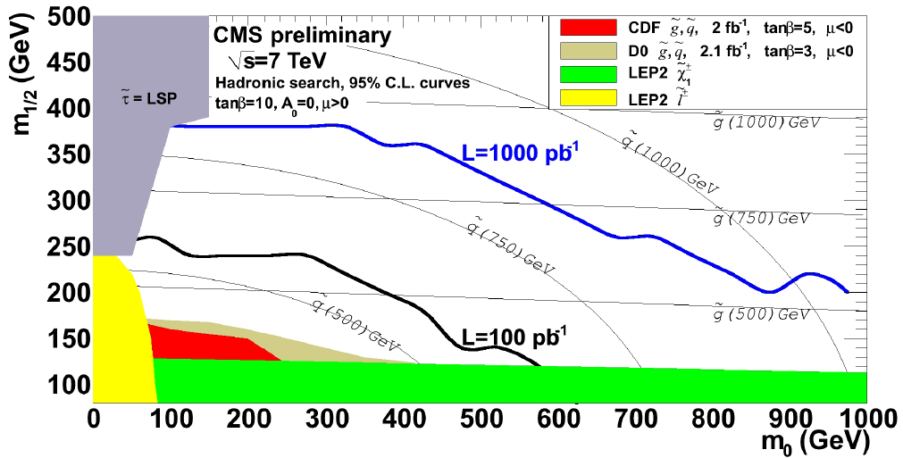
All-Hadronic Final States
Events with no isolated electrons or muons (P_{T} > 15, 10)
At least 3 jets (P_{T} > 50), the missing P_{T} vector pointing away from the leading jets
Backgrounds:
QCD multijet events, Z+jets, W+jets, tt…
Irreducible Z+jets: Z → νν
Sensitivity to SUSY parameter space beyond current Tevatron limits with < 100 pb⁻¹

Slide 22
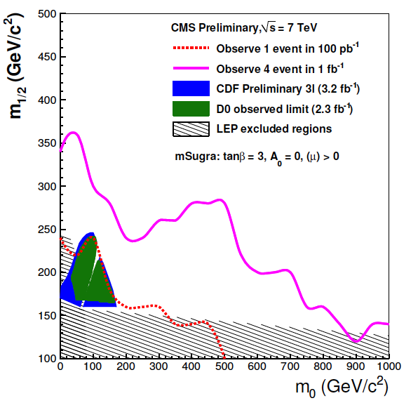
Like-sign Lepton Final States
Very rare event topology but highly suppressed background (~ 1 event / 100pb⁻¹)
At least three jets (P_{T} > 30), the scalar sum of the transverse momentum H_{T} > 200
Same sign pair of isolated leptons (P_{T} > 10, 20) in three channels: ee, eμ, μμ Missing P_{T} > 80
Backgrounds:
Main contribution: tt
Expected 95% CL upper limit contours combining the three channels (7 TeV), as well as the latest exclusion region from CDF and D0

Slide 23
Summary
The performance of CMS in collision data has been very good since the start of the data taking.
At 7-8 Tev with enough luminosity (5 fb⁻¹), CMS will explore the complete range of Higgs mass up to 600 GeV:
– SM Higgs 3σdiscovery sensitivity : [114-600] GeV
– SM Higgs exclusion range : [114-600] GeV
Before the first fb⁻¹ of data is collected, many SUSY searches will be fully performed, and a sizable region of the paremeter space will be explored, reaching sensitivity to regions of SUSY (mSUGRA) parameter space beyond the current Tevatron limits
During next year, a wide catalogue of Higgs, MSSM and SUSY searches will be performed by CMS at the LHC, with potential to exclude and discover new physics in regions never before reached

